Slide 1

AIML_St1511 ca2 (clustering)
Name: Lee Hong Yi (2223010)
Class: DAAA/FT/2A/05

Slide 2
Introduction to task
Objective: The objective of this project is to identify which group of customers are the most valuable to the shopping mall. This information will be used by the shopping mall to develop strategies to retain these customers.
Background Information: The shopping mall has data about its customers, including their age, gender, income, and spending. This data will be used to cluster the customers into groups based on their similarities.
Output Variable: The output variable will be the cluster of customers that are most valuable to the shopping mall. The characteristics of each cluster will also be described.

Slide 3
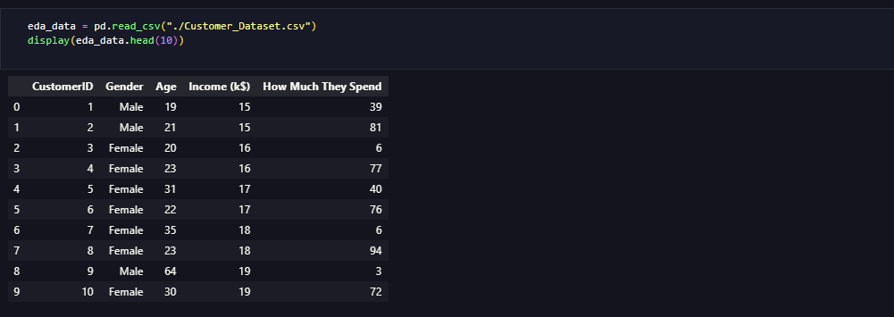
Preparing Data + Eda
Since the data has already been collected, we can move straight onto preparing it, as well as EDA.
From the EDA, we can make the following observations:
- We can see that the median age is 39 years old. With a standard deviation of 13.96, it is quite spread out.
- The average income is 60 thousand dollars. It is also quite spread out, with a standard deviation of 26 thousand dollars.
- The average amount spent is also quite spread out, with a standard deviation of 25$, and a mean of $50.20.
- From the histogram, we can see that females tend to spend more than males, with a much higher peak at 50% compared to males, who have spending more evenly spread across the spectrum.
- From the 3-D scatterplot, there are a few clusters which can already be seen.

Slide 4
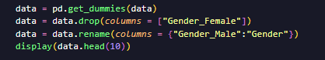
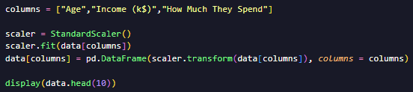
Data preparation + feature engineering
Given that there are categorical variables in the dataset, we shall perform one-hot encoding to transform them into numerical variables.
We will also force the gender column to become dichotomous. By doing so, we force the data to be homogenous, avoiding undue influence.
We will also scale the data given using StandardScaler, so that the euclidean distances between points are calculated in a meaningful manner.
Another way that we can deal with the categorical feature, is to test combinations of features to see if the feature has a large impact on the quality of our clusters, by testing combinations of features, dropping 1 at a time. To do this, we use k-means as a sample model to test the overall impact.
When doing this, we see a minimal impact. To prevent critical loss of data, we keep the feature nonetheless.

Slide 5
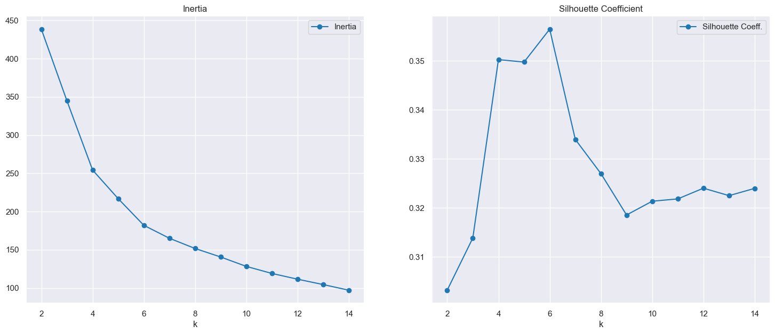
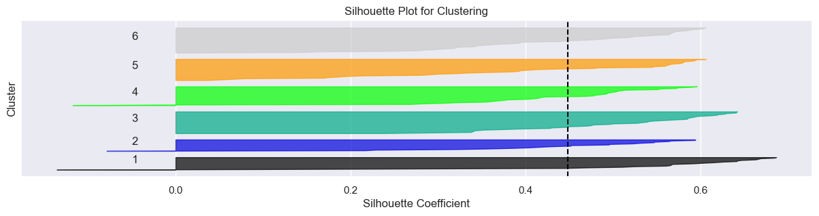
Determining value of k
To help us determine the ideal value of K, we shall use the “elbow” method, as well as the Silhouette Coefficient.
Looking at the plot generated, we can see that the results from the inertia analysis are rather ambiguous, as there is no clear elbow, but, we can see that the highest silhouette value is obtained when k = 6, with a spike between 4 and 6. Thus, we use silhouette plots to help us see which value is best.
Reading the silhouette plots generated, we can see that value to use is still 6. This is as there are no clusters which have a below-average silhouette score. In addition, the sizes of the silhouette plots are relatively uniform, with little fluctuations between each cluster.

Slide 6
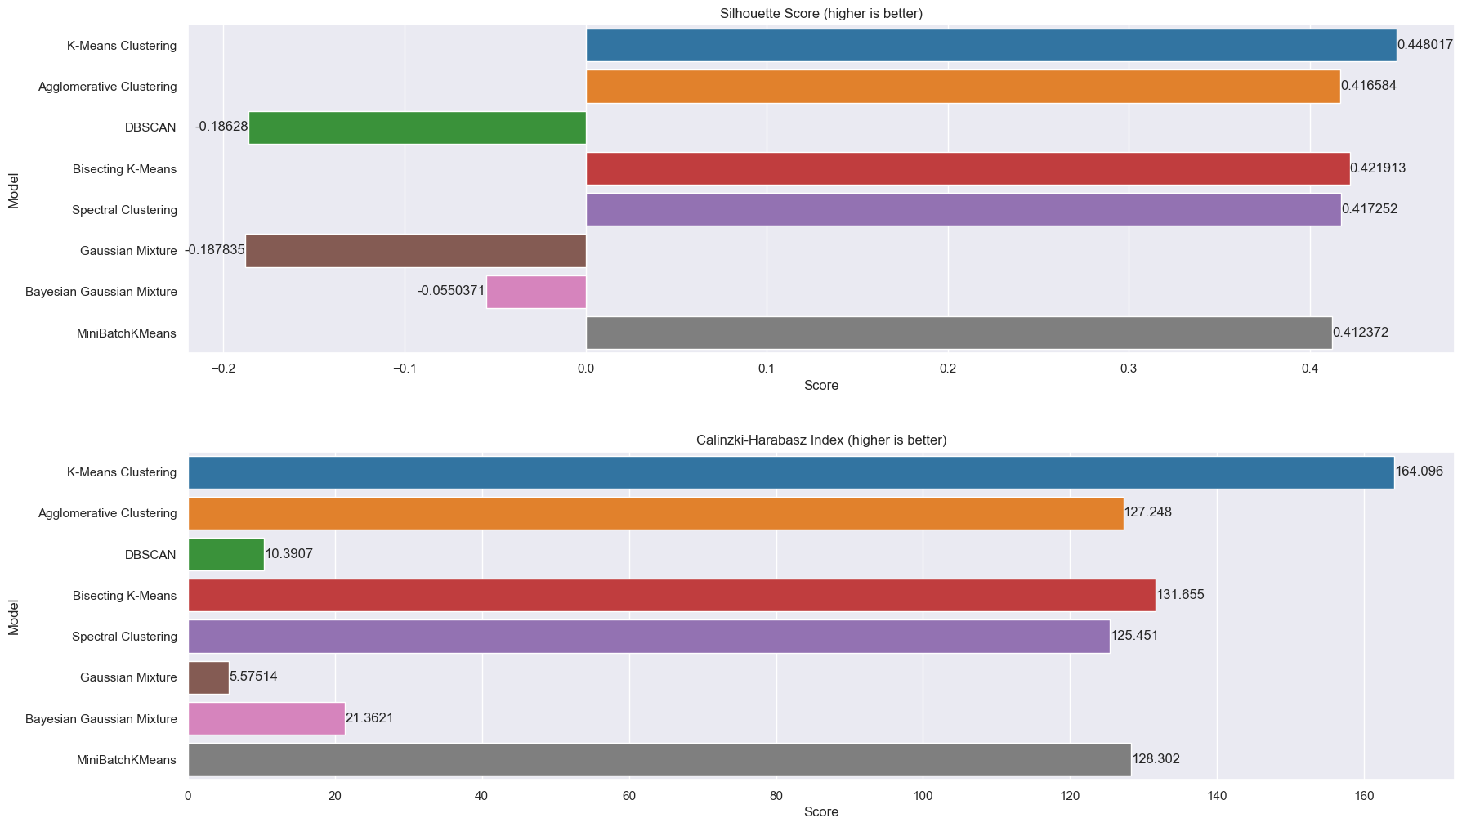
Initial clustering
To start clustering, we first determine a few scoring metrics, as well as models to use.
From there, we pick the few best performing models, and hypertune them to achieve the best results.
To help pick the best models, we use the Silhouette Coefficient and Calinski-Harabasz scoring indexes.
From the graphs, we can see that the K-Means model, as well as the Bisecting K-Means model performs quite well, as both of them have a high Silhouette score, from 0.42 to 0.44, as well as a high Calinzki-Harabasz Index score, ranging from 131 to 164.
From the high score on the Calinzki-Harabasz Index, we can see that the clusters for the two selected models are already quite well defined, with very little overlapping compared to models like DBSCAN and GMM. However, we shall try to further tune and improve on these models to yield better clusters.

Slide 7
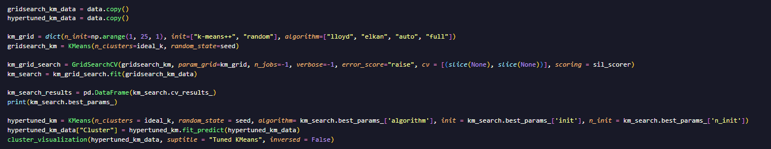
Hypertuning
We hypertune the models using GridSearchCV.
However, we saw no improvement when we hypertuned the models. Hence, we shall use the initial 6-cluster K-Means model as the final model, as it gave the highest silhouette score, and did the best on the Calinzki-Harabasz Index.

Slide 8
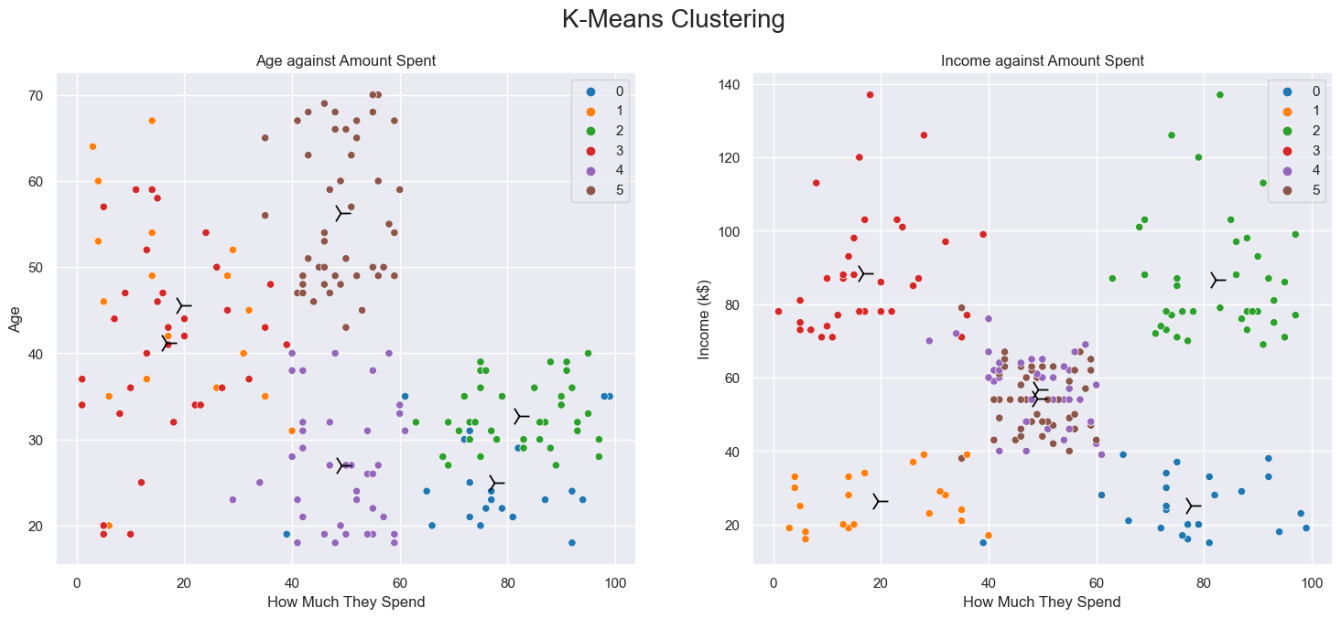
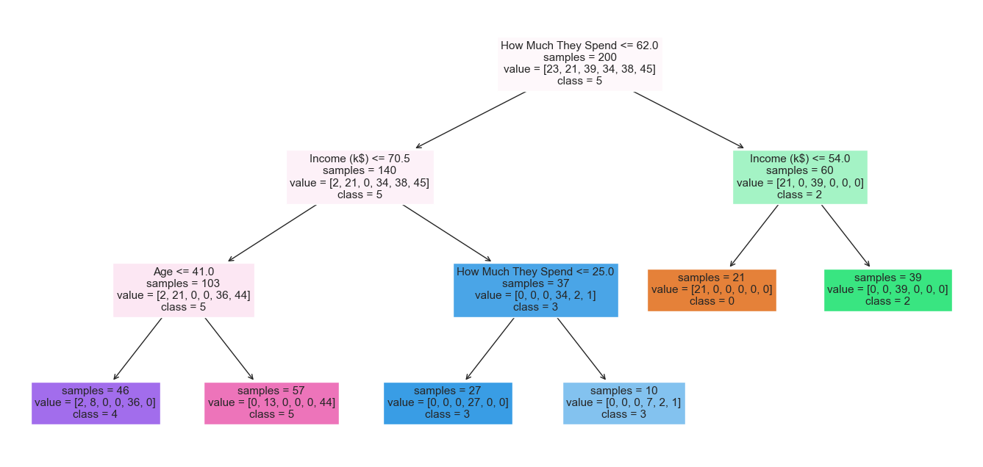
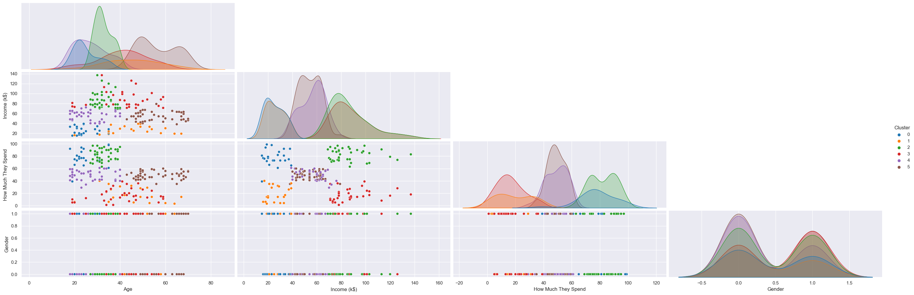
Cluster interpretation (PART 1)
Now that we have selected the models to use, we can interpret the clusters generated. We generate a few graphs, as well as make use of a DecisionTreeClassifier model as a surrogate, to help us gain insights into the decisions made.

Slide 9
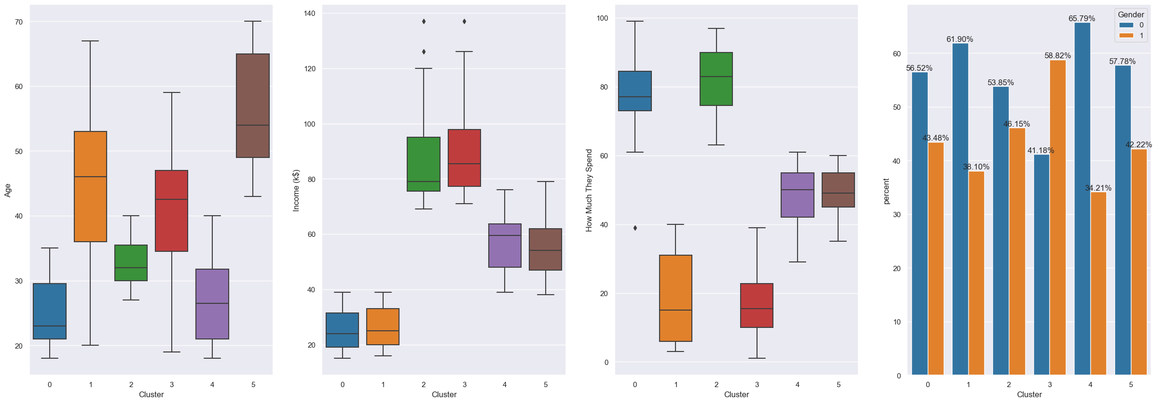
Cluster INTERPRETATION (PART 2)
Cluster 0 (High-spending youths): This cluster contains individuals who are younger and earn less, but spend more compared to the rest. They are likely to be more precious to the mall, as they are more likely to make larger purchases..
Cluster 1 (Good Financial Management): This cluster contains individuals who are spread over a wide age group, but earn a relatively low amount. They are likely to be consistent spenders, given that they are more likely to spend within their means
Cluster 2 (High-flying Individuals): This cluster contains individuals who are middle aged and earn more compared to the rest of the customers. They are likely to be a major source of revenue for the mall.
Cluster 3 (Savvy Shoppers): This cluster contains individuals who have a high income but spend relatively little. The mall's management can look into enticing this cluster of individuals to spend more.
Cluster 4 (Modest Spenders): This cluster is made up of young, middle-income, mostly female consumers who spend a moderate amount of money. They are likely to spend a moderate amount of money and spend within their means.
Cluster 5 (Older, middle-income consumers): This cluster is made up of people who are older than most and earn more than the dataset average. They are likely to be average spenders and make up the bread and butter of the mall.

Slide 10
COnclusion
From this exercise, the mall can conclude that it has 6 distinct groups of customers, each making up a different part of it's customer base.
If the mall were solely focussed on profits, it would look to maximizing profits from individuals belonging to cluster 0, and cluster 2, as they spend the most, raking in the most revenue. The mall can likely do this by bringing in more fashion/technology brands, such as ADLV, Zara, and Apple. These brands are more likely to be popular with customers from those clusters, as they are younger people, who are willing to spend on more expensive, name-brand products.
If the mall were focused on long-term survival, it could focus more on Cluster 1/5. This is as customers in those clusters have better financial management, making them more likely to be consistent customers, coming back on a frequent basis to purchase items. Their spending behaviour is likely to be relatively consistent and hence, management can look to introduce sales/promotions on a more frequent basis to hopefully generate a pull factor, to keep these customers for longer.

